Slide 1
JavaScript Function

Slide 2
Functions
Function Object
Function declaration
Passing arguments by value and reference
Variable scope
Function Overloading
Optional argument
Argument objects
Argument hashes
Properties and methods of Function object

Slide 3
Function Object
In JavaScript all functions are first-class instances of a global object called Function.
Function object has certain properties and methods that can be accessed by all functions.
The function objects can be passed as arguments to other functions and can be returned by other functions.

Slide 4

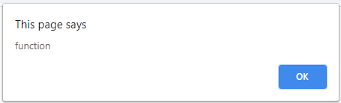
Function Object

Slide 5
Declaring functions
Using function statement
Using function literal or anonymous function
Using Function class constructor

Slide 6
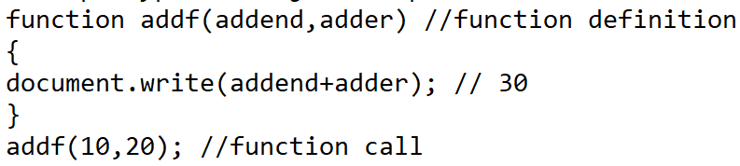
Declaring functions – function statement

Slide 7
Declaring functions – Anonymous function
An anonymous function does not have a name.
Anonymous functions can be passed to other functions.

Slide 8
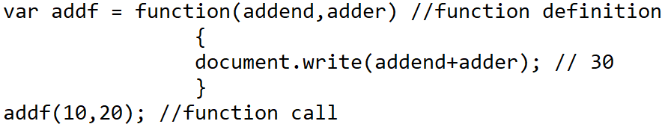
Declaring functions – Anonymous Functions

Slide 9
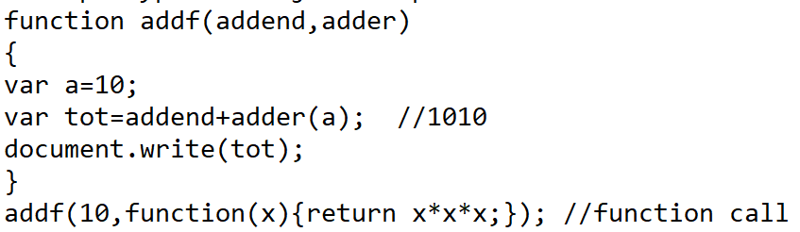
Passing Anonymous Functions as Arguments to other Functions

Slide 10
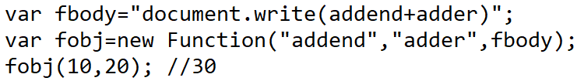
Declaring functions – Function Constructors

Slide 11
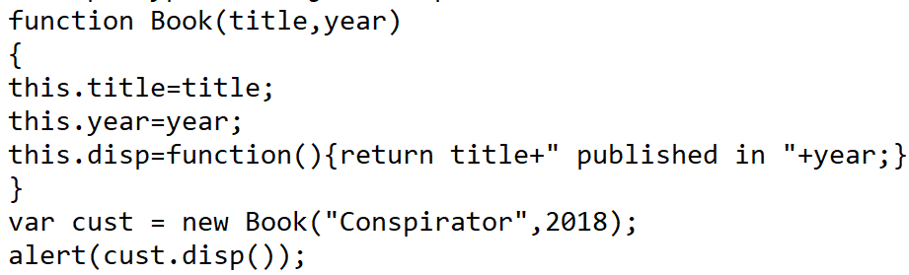

Declaring functions – Custom Function Constructors

Slide 12
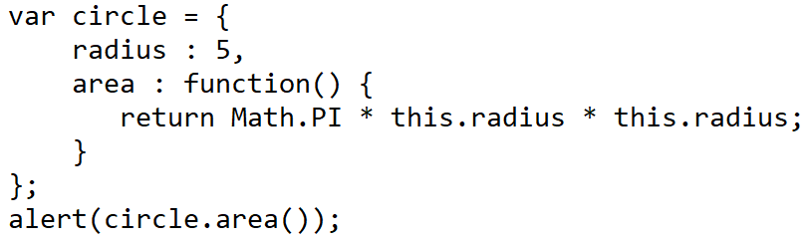

Declaring functions in an Object

Slide 13
Passing Arguments
By value
When primitive datatypes are passed to a function they cannot be modified outside the function
Primitive datatypes (number, string, boolean,null,undefined)
By Reference
In composite type it is possible to modify their value outside the function
Reference types (Object, Array, Function, Date, RegExp, Error)

Slide 14
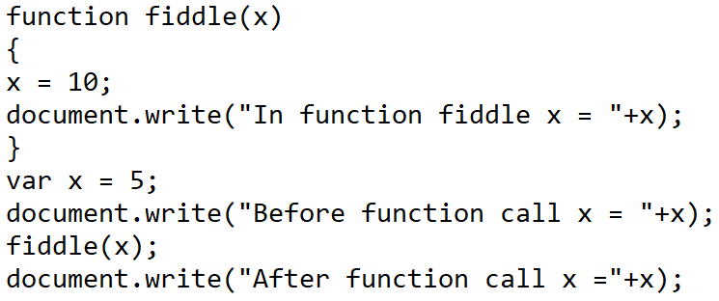
Passing Argument by Value

Slide 15
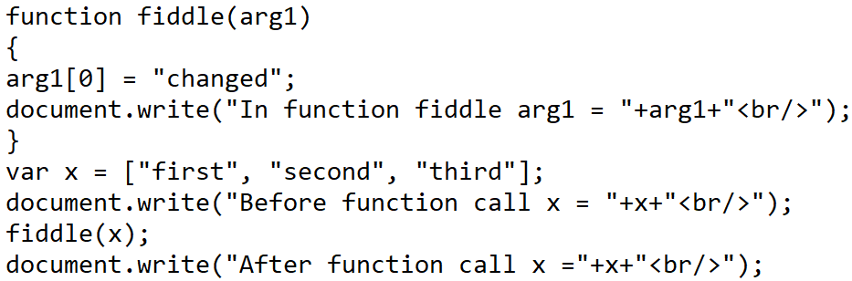

Passing Argument by Reference

Slide 16
Passing Functions as Callbacks
A callback function is a function that is passed as an argument to another function that will be called back later.
The function that accepts the other function as argument is called higher-order function.
The higher-order function has the logic when the callback function needs to be executed.

Slide 17
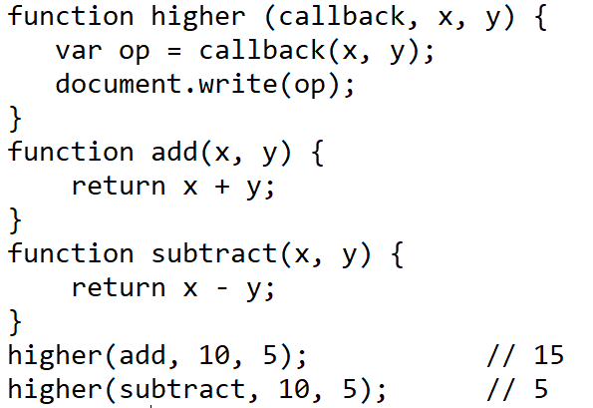
Passing Function Callbacks

Slide 18
Return values
All functions return value.
When no return statement is specified “undefined” is returned.
To return value in a function use return statement.

Slide 19
Variable scope
Scope refers to accessibility of a variable in a program.
Local – Accessible only within the function
Global – Accessible throughout the program
Explicit declaration of variable uses var refers that the variable is declared in the current scope. (If declared outside-global, If declared inside a function or loop then it is local).
Implicit declaration does not use var and provides a global scope

Slide 20
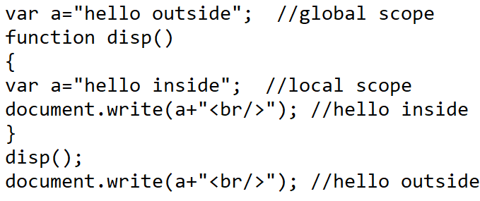
Variable scope

Slide 21
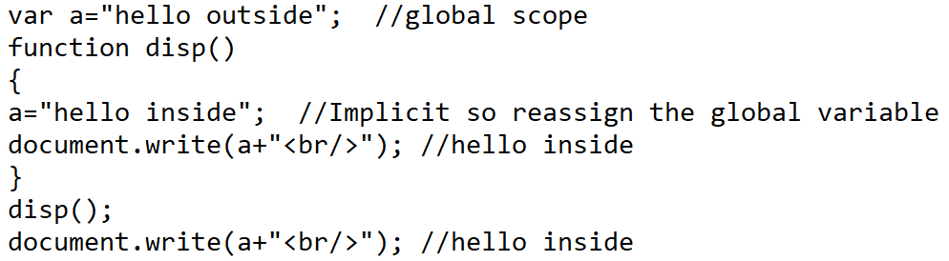
Variable scope

Slide 22
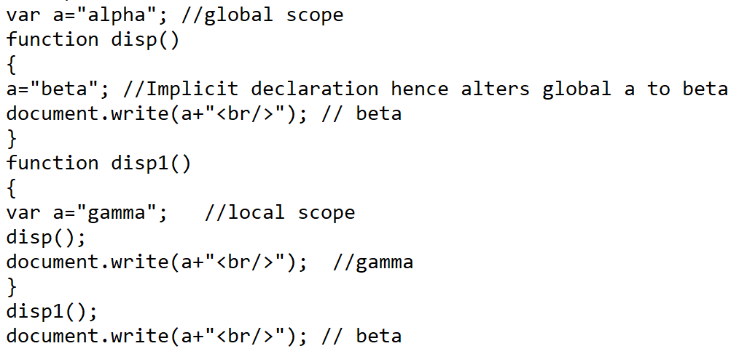
Variable scope

Slide 23
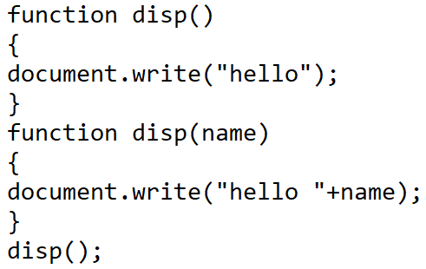

Function Overloading
JavaScript does not support function overloading directly.
When functions are overloaded the recent definition will be called.
As the function pointer holds only the reference the recent function overwrites the original memory location.

Slide 24
Function Overloading through Anonymous Function
Copy the pointer to a new variable before rewriting the old function.
The second function is created as an anonymous function so that new memory is allocated.

Slide 25
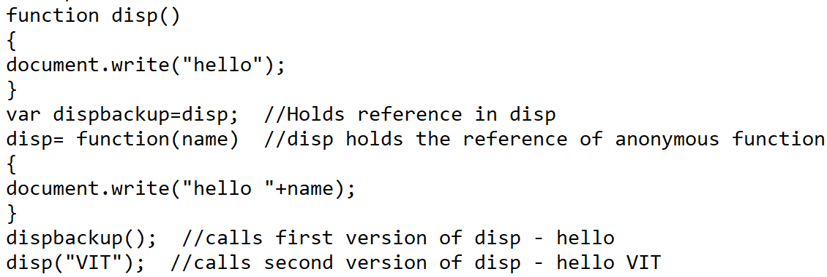
Function Overloading through Anonymous Function

Slide 26
Optional Arguments
JavaScript does not support optional arguments.
When the argument is not passed it is treated as undefined.

Slide 27
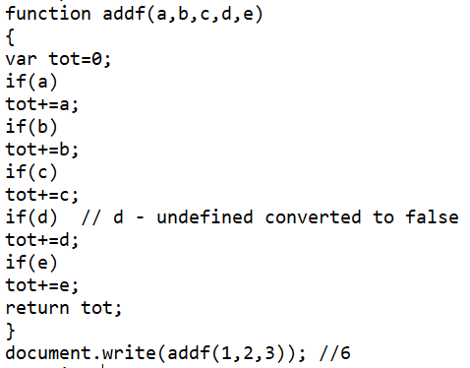
Optional Arguments

Slide 28
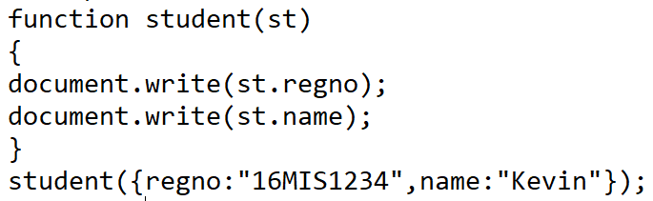
Argument Hashes
An associative array or a hash or an Object can also be passed to a function.

Slide 29
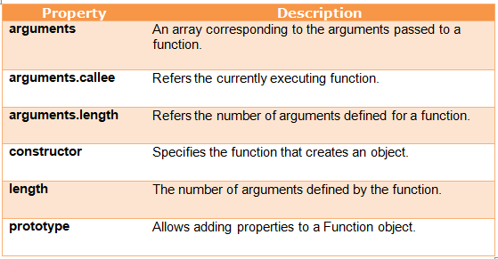
Properties of Function object

Slide 30
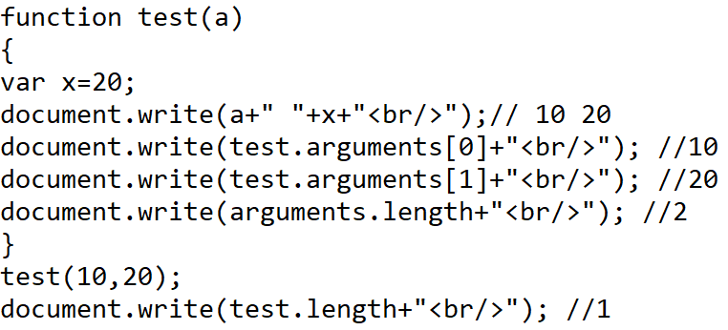
Properties of Function object

Slide 31
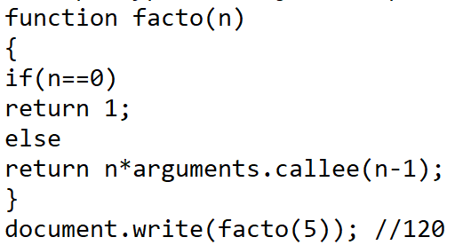
Properties of Function object

Slide 32
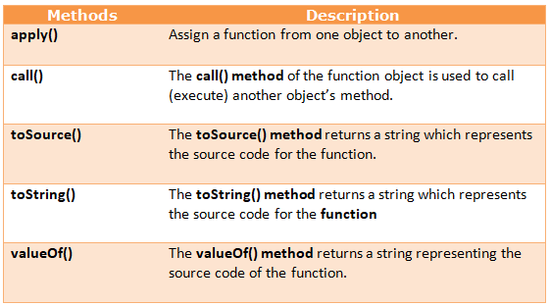
Methods of Function object

Slide 33
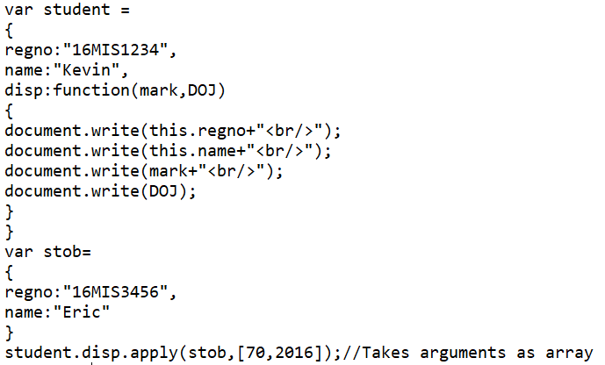

apply() - Demo

Slide 34
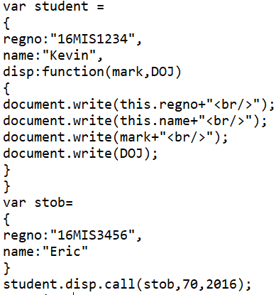
call() - Demo

Slide 35
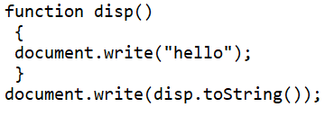

toString() - Demo

Slide 36
REFERENCE
Alexei White, JavaScript Programmer’s Reference, Wrox, ISBN:978-81-265-2363-4

